Slide 1


Reservoir Sediment water filtration &
De-chlorination system

Slide 2
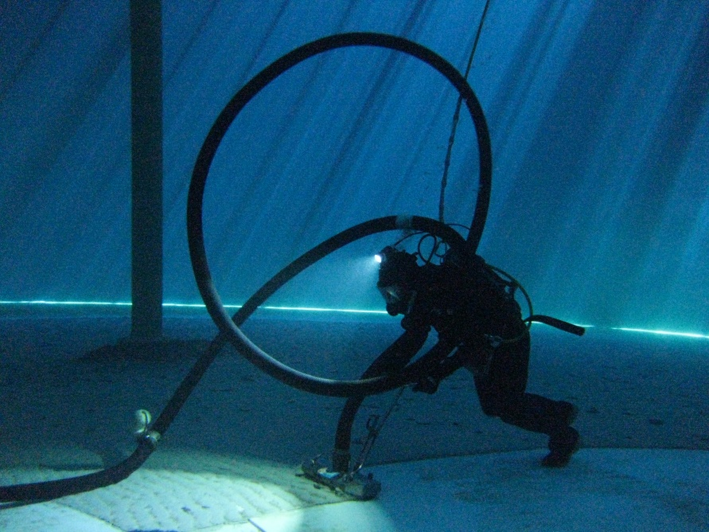
Potable water reservoirs are susceptible to :
Potable drinking water reservoirs
Resulting in environmental and water quality issues
Sediment vacuumed by tank divers pumped to sewer or stormwater – increasing turbidity levels
Increase strain / demand on water treatment plants
Compromising water quality
High levels of sediment build up
Lime / Floc settling on tank floor
Contamination- corroding galvanised steel ladders
Contamination – Asbestos roofing
Contamination – Rotten roof rafters
Potential blockage of piping / valves and distribution system

Slide 3
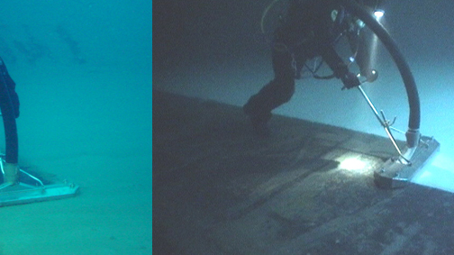

Divers vacuuming built up sediment from reservoir floors

Slide 4
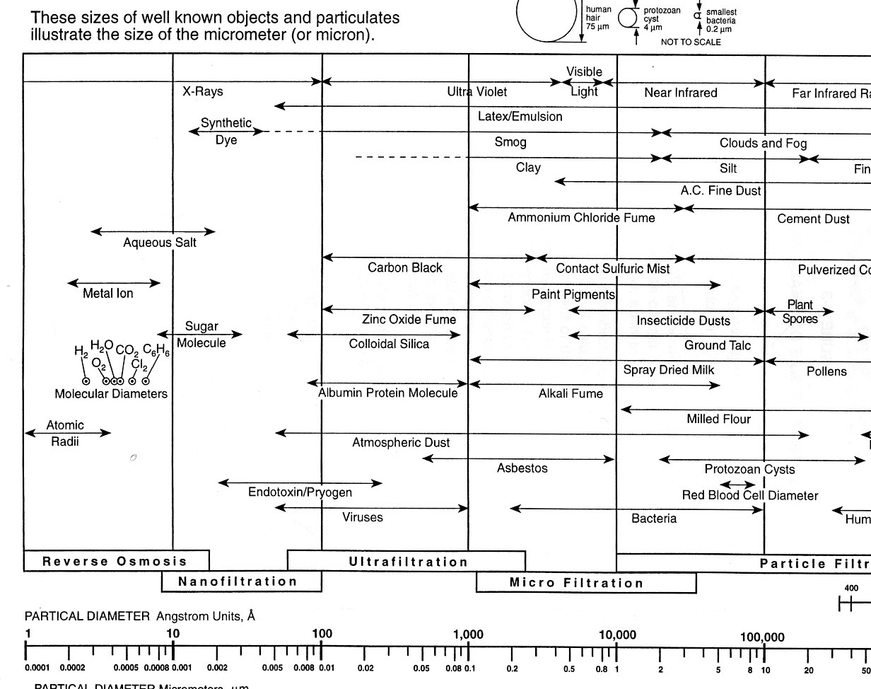
PARTICLE SIZE REMOVAL RANGE BY FILTRATION
Notes:
Microfiltaration is the range we can reach today with many of our products.
Reverse Osmosis is best suited for the total removal to avoid imparting any objectionable tastes and then blend back if needed.

Slide 5

Suspended Solids
Drinking water typically has a suspended solids concentration around 0 mg/L.
For maintenance activities, suspended solids concentrations can vary dramatically. The discoloured water discharged during swabbing for example can exceed 1000mg/L.
The best guide for use in the field is appearance, if the water being discharged is discoloured; it is likely exceeding the discharge criteria of 30 mg/L Various measures can be implemented to ensure discoloured water is not discharged to the receiving stream.
The median suspended solids concentration in flushing water is normally less than 30mg/L; however, spikes above 30mg/L may be experienced for some periods in some locations

Slide 6
Level of sediment removal – Particle reduction sizes
Micron | mm | Mesh
800 | 0.8 | 20
500 | 0.5 | 30
300 | 0.3 | 50
250 | 0.25 | 60
200 | 0.2 | 75
180 | 0.18 | 80
150 | 0.15 | 100
130 | 0.13 | 120
100 | 0.1 | 150
100 | 0.1 | 155
80 | 0.08 | 200
50 | 0.05 | 300
40 | 0.04 | 350
30 | 0.03 | 500
25 | 0.025 | 600
15 | 0.015 | 1000

Slide 7

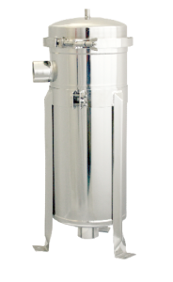
Reservoir waste water sediment treatment system
High Performance Industrial Water Treatment System:
Industrial Water Filter Housing specially designed for high flow and high volume applications using the highest quality components and packaged in a complete and easy to install housing.
Utilizing easily replaceable, large surface area, high-flow, polypropylene filter bags, the Industrial Water Filter system can filter to 5, 10, 25 or 500 microns at flow rates up to 2000 lpm per minute.
High Performance Filtration Up To 800 litres Per Minute (48,000 LPH)
Stainless Steel 304 Construction
EPDM O-rings at Inner Sleeve and Upper Seal
Hinged V-clamp Closure Design
Pressure Gauge and Purge Valve Included
Adjustable Tripod Stand with Bolt Mounts

Slide 8
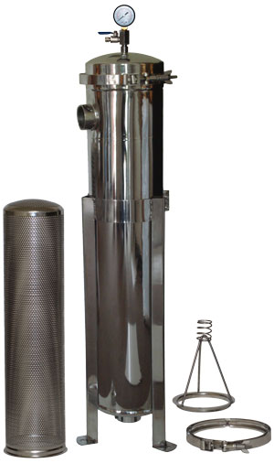
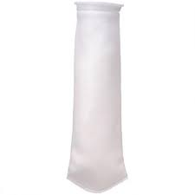
Bag filter
A Bag filter works by the principle of microfiltration. The liquid is purified in bags by passing small permeable pores. Bag filters can be used for large amounts of water.
The liquid flows from the top of the filter housing manufactured in stainless steel and is distributed equally amongst the bag. The liquid comes out at the bottom leaving the dirt behind.
Since the bag is locked in at the top of the vessel all the dirt is trapped inside the bag.
The sizes of these pores are between the 1-500 micron . The capacity depends on the surface area from the bags. Bigger systems can clean up to more than 500 m³ /h (multi bag filters)

Slide 9
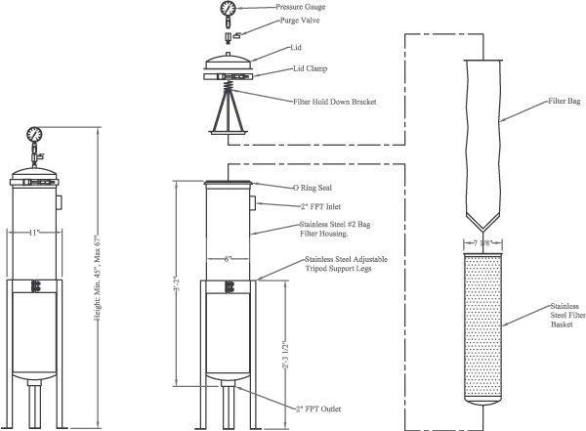

Slide 10
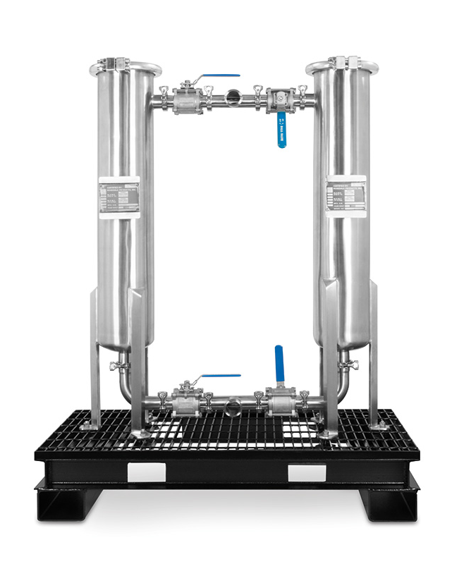
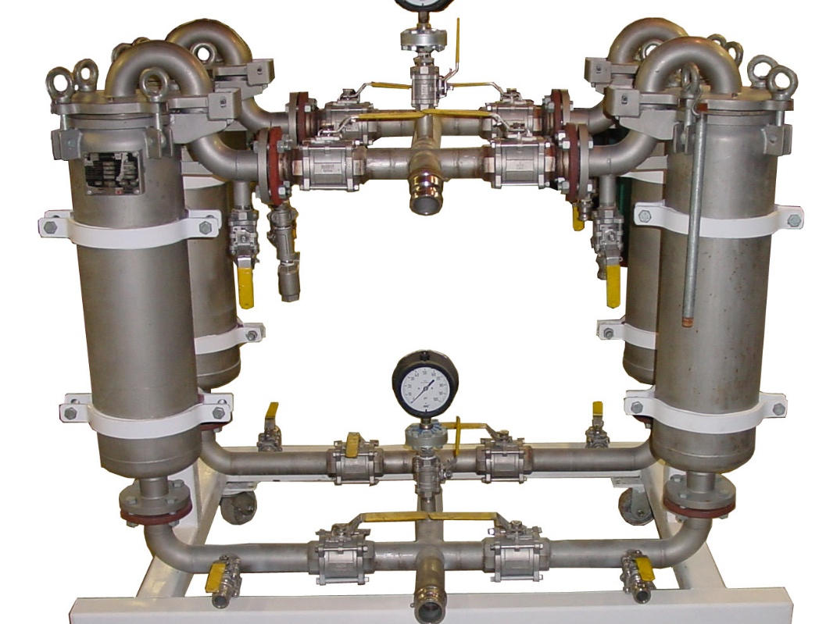
Higher Flow Higher Capacity sediment removal

Slide 11
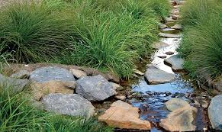
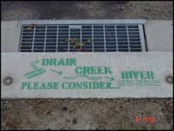
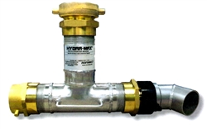
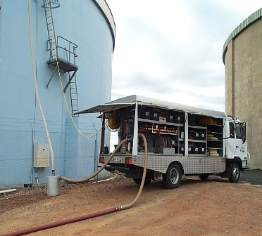
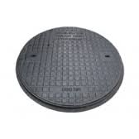
Heavy sediment removal & Dechlorination –
Stage particle size reduction systems
Inlet
Discharged to stormwater
Stage 1
Heavy Sediment
200 Micron filter bag
Stage 4
Dechlorination
Total & Free Chlorine
Stage 2
50 Micron filter bag
Stage 3
10 Micron filter bag

Slide 12
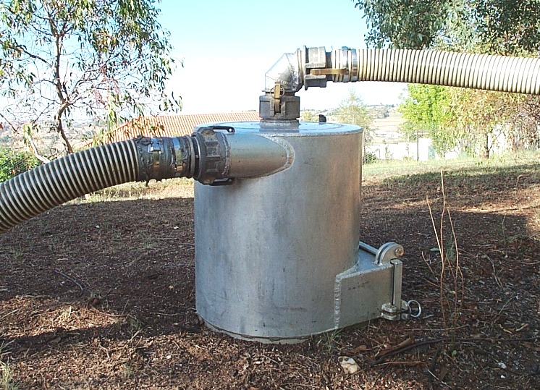
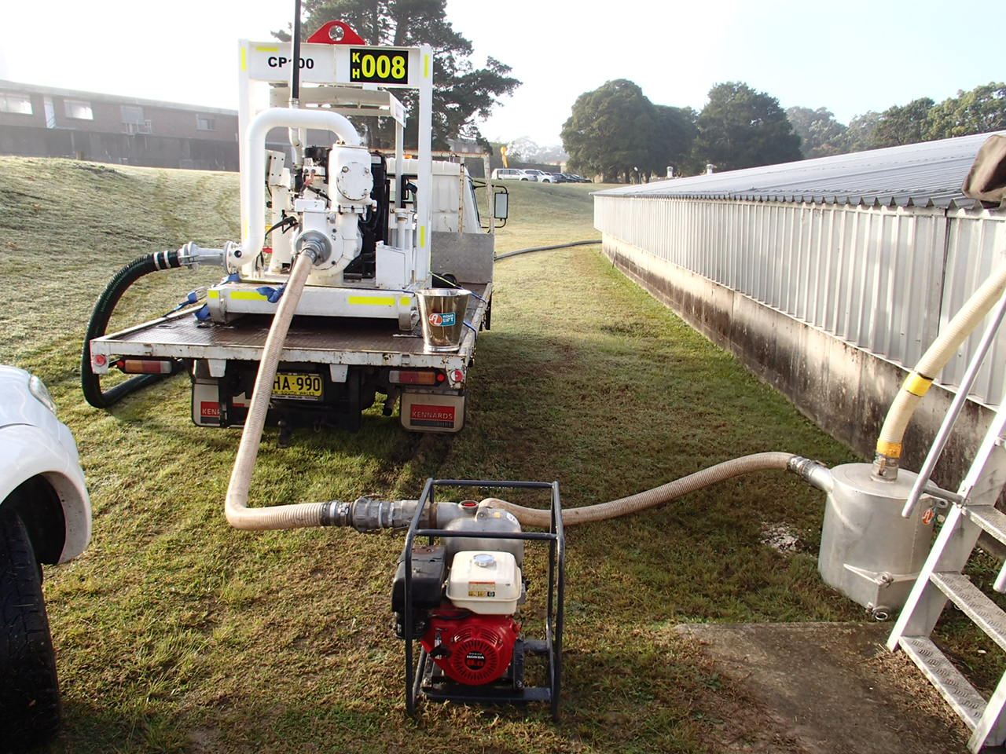
Diving suction hose heavy sediment filter unit filters out large debris down to 8mm
Sediment is filtered and disposed off site
Dive truck equipped with high pressure pump and heavy sediment filter unit

Slide 13
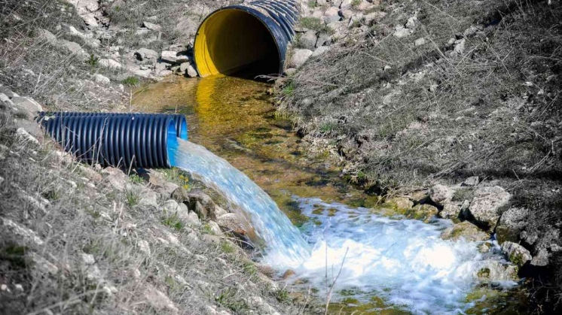
Why filter reservoir waste water ?
Environmental
  Discharging clean contaminant free water direct to rivers/streams
  Removing Chlorine
  Removing Sediment / Turbidity to meet EPA
  discharge standards
Cost reduction
  Reduce sewer discharge costs
  Reduce water treatment plant costs
  No requirement to cart

Slide 14

Dechlorination
“The practice of removing all or a specified fraction of the total chlorine residual”

Slide 15
Dechlorinating - Scope
The relevant activities involving the discharge of water to the environment or receiving streams are:
Discharge of drinking water (e.g. to permit maintenance or construction work on a water main, pumping station or reservoir)
Cleaning water mains (eg. flushing, swabbing & scouring);
Cleaning water supply reservoirs
Disinfecting water mains (eg. new mains, existing mains following main breaks) or water supply reservoirs
Discharge of water from excavation pits
Discharge of contaminated drinking water in emergency circumstances.

Slide 16
Term | Definition
Drinking Water: | Water that is of a quality acceptable for supply to customers for drinking purposes, in accordance with the Australian Drinking Water Guidelines.
Contaminated Drinking Water: | Water that is of a quality unacceptable for supply to customers for drinking purposes.
Super-chlorinated Water: | Water that is highly chlorinated to concentrations of 2mg/L to 20mg/L (or higher), typically after main breaks, swabbing, or for new mains not yet commissioned.
Other Grades of Water: | Non-drinking water that has been reclaimed for useful purposes
Discharge Water: | The water discharged to the environment as a result of maintenance activities carried out on the water supply mains and reservoirs. It includes any associated substances or pollutants contained in the water.
Receiving Waters: | Any waters, dry creek lines, drain, channel, or gutter used or designed to receive or pass rainwater, floodwater or any water that is not polluted.
Sensitive Waterways: | Any other habitat-providing waterway (whenever possible to be determined by Sydney Water Environmental staff based on extent of streambed modification, aquatic habitat and riparian vegetation).
Dechlorination: | The practice of removing all or a specified fraction of the total chlorine residual.
Emergency circumstances: | An emergency is a sudden or urgent occasion when there is a need to discharge contaminated water to the environment or receiving streams. Eg. Discharge of super-chlorinated water, discoloured water, or water containing other pollutants.

Slide 17
Discharge Assessments
Discharge assessments are required for certain planned activities, where discharges have not been assessed as part of a project specific When an assessment is required, the Project Manager will provide a brief description of the works for assessment.
Details will include:
Scope of the works
Proposed timeframe
Volume and expected quality of the discharge water
Location of discharges (from what asset to what receiving stream, including description of travel path)
Digital photos of the discharge locations and point of entry to receiving streams.

Slide 18

Discharge Assessment continued
Then assess the information provided and notify the Project Manager as to which of the following categories the work is deemed to fall within:
  No further assessment required – discharge protocols apply.
  Sensitive environment - minor Environmental Impact Assessment required. (Discharge protocols apply and additional safeguards to cover site-specific issues).
  Sensitive environment - Review of Environmental Factors is required. Discharge protocols apply and other approvals may be necessary. This assessment will be required in areas such as National Parks

Slide 19
Discharge Assessments
All reasonable steps will be taken to ensure that the discharge water does not cause erosion, which could increase turbidity in the receiving waters. Where discharge occurs overland, the discharge velocity shall be as low as possible to minimise erosion, and sedimentation and erosion controls such as filter socks, sediment fences, hay bales wrapped in geotextile fabric, coir logs, etc. shall be implemented as soon as practicable.
Consideration shall be given to reusing the discharge water where practicable leading to gains for the end user.
No water shall be intentionally discharged onto private land without the prior approval of the property owner. In each case the property owner should be made aware of the typical water quality characteristics prior to discharge

Slide 20
Dechlorinating of Reservoirs
The relevant activities involving the discharge of water to the environment or receiving streams are:
Discharge of drinking water (eg. to permit maintenance or construction work on a water main, pumping station or reservoir);
Cleaning water mains (eg. flushing, swabbing & scouring);
Cleaning water supply reservoirs;
Disinfecting water mains (eg. new mains, existing mains following main breaks) or water supply reservoirs;
Discharge of water from excavation pits; and
Discharge of contaminated drinking water in emergency circumstances

Slide 21
Chlorine ? What do we need to test for ?
There are three forms of residual chlorine in water treatment:
Free - Residual chlorine composed of dissolved hypochlorite ions, hypochlorous acid and chlorine gas
Combined - Composed of chloramines that can kill bacteria and oxidize organic matter
Total - The sum of free and combined residual chlorine

Slide 22
Total Chlorine Residual
In drinking water, total chlorine residuals typically vary between 0.2 and 1.5 mg/L. On occasions there may be a requirement to dechlorinate this water, such as for large volumes .
If the chlorine residual prior to discharge is zero, there is no requirement to dechlorinate the discharge water.

Slide 23
EPA Discharge water quality limits
Parameter | Discharge Limit
pH range | 6.5 – 8.5
Total chlorine residual | 0.01 mg/L *
Fluoride ion | 1.5 mg/L
Suspended solids | 30 mg/L
Other Contaminants | Seek advice from EPA

Slide 24
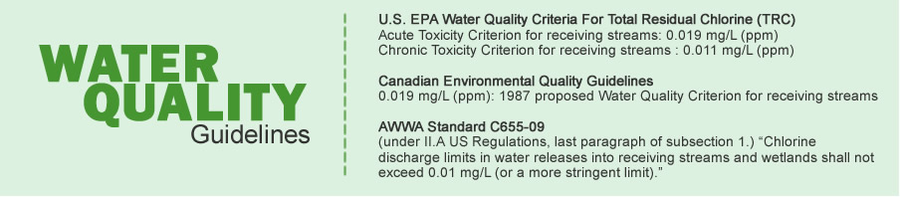
Water Quality Guidelines – USEPA & EPA (Australia)

Slide 25

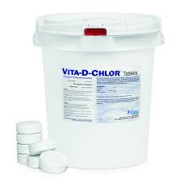
Field declorination system- Dive clean operations unit
The de-chlorination diffuser provides a reliable
method of removing chlorine residual from water flows.
Designed to dose Enviro-C Vitamin C or Vit D Chlor de-chlorination tablets, the system provides complete neutralization of chlorine and chloramines from water flows.
The unit provides a chemical dose in direct correlation to the amount and velocity of the incoming flow.
Dive operations team incorporates the de-chlorination system when completing a potable water reservoir clean

Slide 26
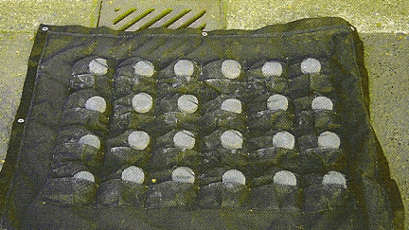
High velocity high volume scour discharges
Higher capacity dosing systems for high velocity water discharge
Liquid ( based on venturi )
Granular slow dissolving
Geotextile matts containing slow
dissolving tablets

Slide 27
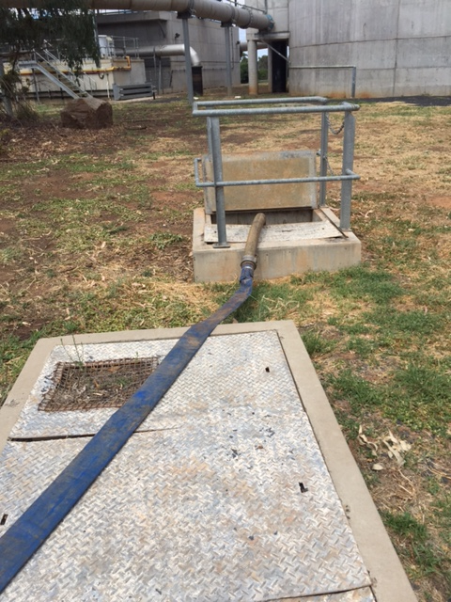
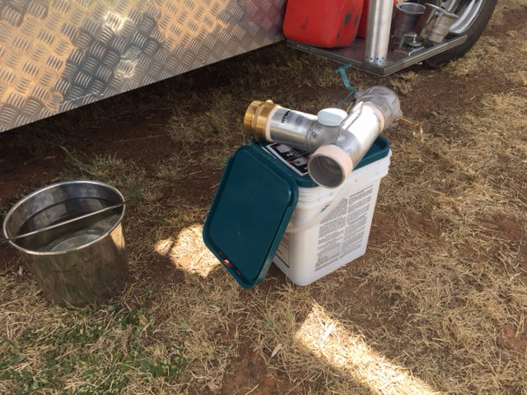
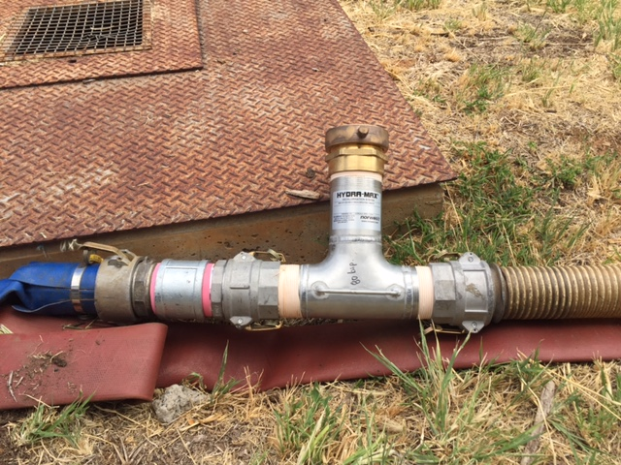
De-chlorination Field test Water Treatment Plant

Slide 28
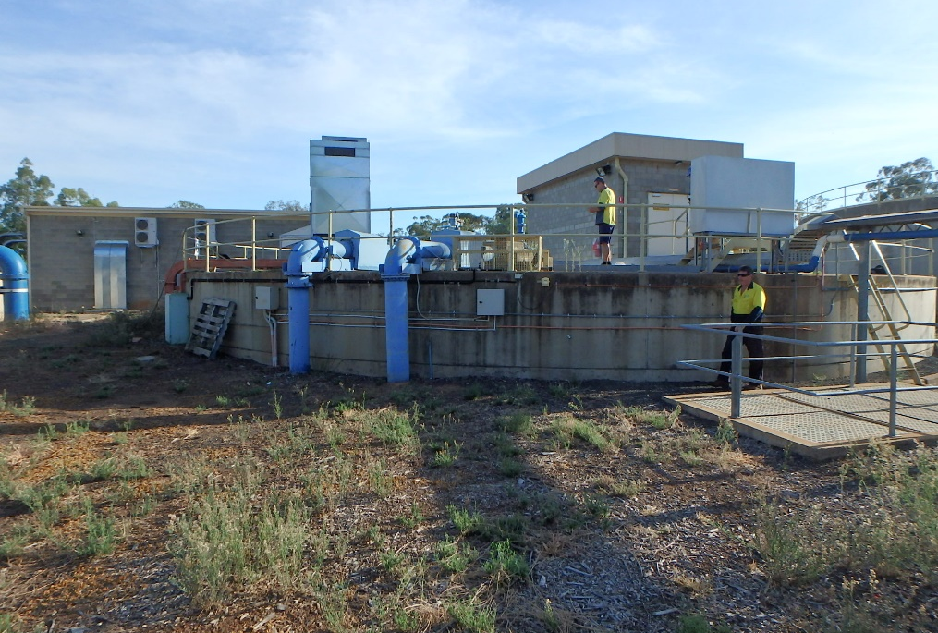
Field test – Dubbo Water Treatment Plant
Scope :- Test effectiveness of field dechlorination system in
Reducing Chlorine from discharged water out of reservoir tank
Site :- Dubbo Water Treatment Plant – Clear water tank 1

Slide 29
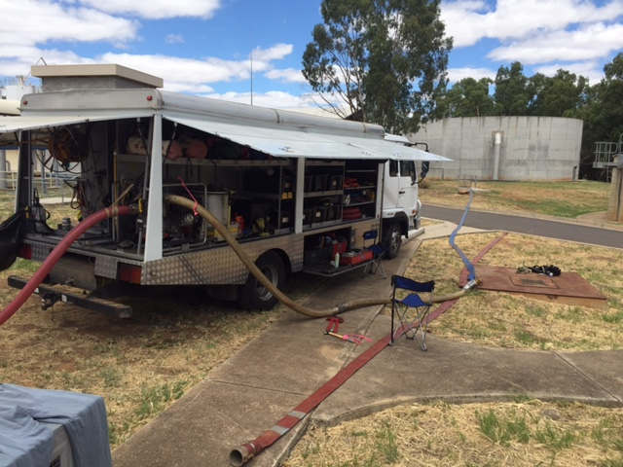
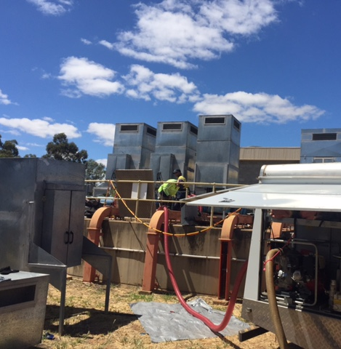
Field test –
De-chlorination
Site :- Routine water vacuuming and internal inspection of Clearwater tank No.1

Slide 30
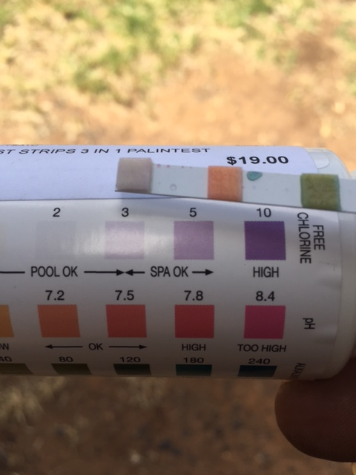
Field test – Dechlorination
Water sample taken from Clear water Tank. No 1
Free Chlorine – 4ppm
pH – 7.2
Alkalinity – 50 ppm

Slide 31
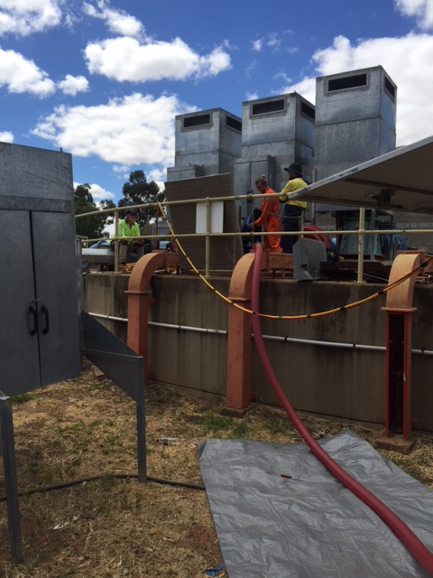
Field test – Dechlorination -Equipment set up
Inline De-chlorination unit installed
3” vacuum line connected to 600lpm pump
Discharge point
3” vacuum line placed inside Clearwater tank

Slide 32
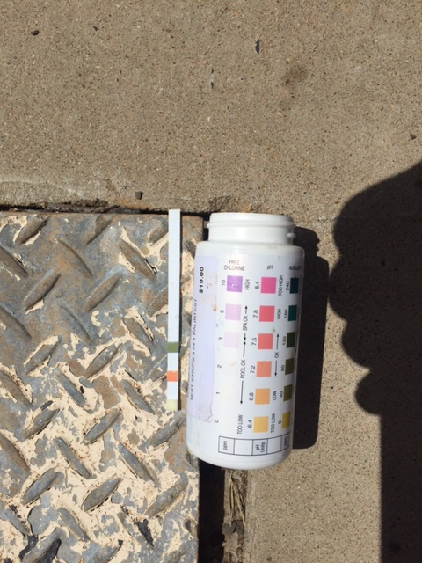
Field test – De-chlorination
Water sample taken from discharge water pit after Declorination :-
Free Chlorine – 0.113 ppm
pH – 7.5
Alkalinity – 40 ppm
Result :- 98 % Removal of free Chlorine

Slide 33
Dechlorination
Vita-D-Chlor and Vita-D-Chlor Neutral are NSF certified for treatment of drinking water. Vitamin C based chemistry makes them safe for neutralizing chlorine in water that is being discharged to the environment and other sensitive areas. Vita-D-Chlor and Vita-D-Chlor Neutral are both 100% organic, completely soluble, and provide a safe, rapid and complete method of dechlorination. These products completely neutralize both chlorine and chloramines.
Developed in response to The Clean Water Act and the Endangered Species Act, Vita-D-Chlor is safer than the sulphite chemicals traditionally used. Vita-D-Chlor is produced using Vitamin C (Ascorbic Acid) chemistry necessary for healthy fish. Vita-D-Chlor does not deplete oxygen levels, a concern when using sulphites. Vita-D-Chlor is used all over the continent for safe, fast, and efficient dechlorination, and offers operator safety and positive public acceptance.
Ideal for field dechlorination where treatment must be safe and immediate, fed it into the flow stream of chlorinated water. As the feed solution disperses across the flow stream, the chlorine is neutralized. Feed solutions of Vita-D-Chlor or Vita-D-Chlor Neutral can also be added to contained water, such as a water truck or reservoir. Introducing it, before filling, generally gives it the necessary dispersal across the volume of water. Just one gram of either product will neutralize 1 ppm (mg/L) of chlorine in 100 gallons of water.

Slide 34
Vita D Chlor – De-chlorination Tablets
Vita-D-Chlor is a more environmentally conscious method of de-chlorination than traditional sulphur-based chemicals. Unlike sulphur-based compounds, Vita-D-Chlor is not toxic to humans or animals, nor does it deplete oxygen in treated water. Key benefits are enhanced environmental protection, operator safety and public acceptance.
Vita-D-Chlor provides a safe and effective means of complying with EPA regulations for the dechlorinating of water prior to flushing into streams, lakes and groundwater
Tablets offer simple and fast set up for treating potable water in dewatering and flushing applications. Most of these devices were developed for the use of Vita-D-Chlor tablets and dose at rates for treating volumes of over 200 gallons per minute with chlorine levels, generally up to 5 ppm. Dissolve rate: Approx. 2.5 grams/min in a 5 gpm stream.

